Slide 1
Time and Frequency Domain Representation of Signals
A signal is a function which represents the time variation of a physical variable.
A continuous time signal is one that is defined for all time instants, t, in an interval of interest. It is usually represented as a waveform
Much of the focus in this module is on continuous time signals.
There are 2 ways to view a signal : time domain and frequency domain

Slide 2
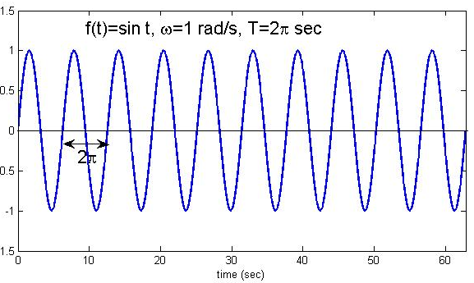
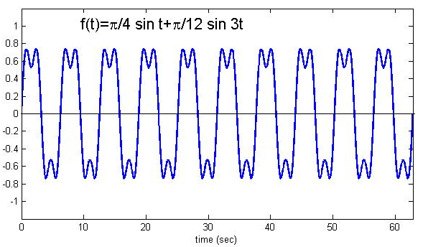
Time domain signals
Example 1 :
Amplitude = 1
Phase = 0
Frequency = 1 rad/s
Example 2 :
amplitudes
2 frequencies : 1 and 3 rad/s
Both signals given in terms of time t. Hence the term “time domain”

Slide 3
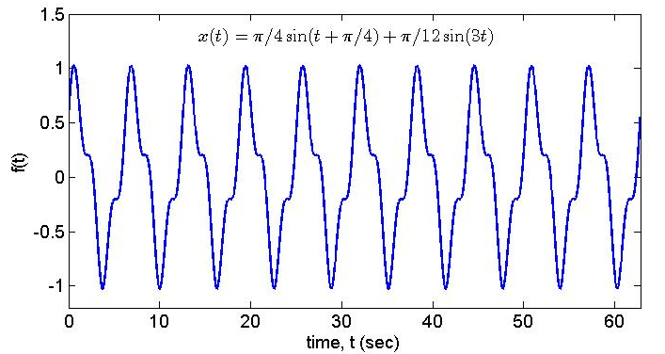
Phase
Signal with same frequency components but with a phase shift in the first component :
Phase
x(t) different from f(t) even though they have the same frequency components but with a phase shift in the first component

Slide 4
Frequency Domain Representation
What does this mean? How do you view a time domain signal in frequency domain?
In examples 1 & 2 in the previous slide, the two signals are periodic.
Easy to see what are its constituent frequencies.
Signal has frequency = 1 rad/s
Amplitude = 1
Signal has 2 frequencies :
1 and 3 rad/s
Each component has :
amplitude : π/4 and π/12
Phase : 0

Slide 5
How can you represent the same signal, x(t), in the frequency domain?
x(t) has two frequency components, 1 and 3 rad/sec.
The component with frequency 1 rad/s has amplitude π/4 and phase π/4
The component with frequency 3 rad/s has amplitude p/12 and phase 0.
π/4
Amplitude
π/12
2 plots required to represent a signal in frequency domain
1
3
Frequency, rad/s
π/4
Phase
0
1
3
Frequency, rad/s
How do you decompose arbitrary signals into its frequency components?

Slide 6
Fourier Series and Fourier Transform
Periodic signal : use Fourier Series to decompose the signals into its
frequency components
Aperiodic signal : use Fourier Transform to decompose the signals into
its frequency components
An arbitrary periodic signal can be synthesized from or decomposed into a finite or infinite number of harmonically related periodic signals. This statement leads to the Fourier Series representation of an arbitrary periodic signal as follows :
Trigonometric form
ω₀ = fundamental frequency in rad/s, T₀ = fundamental period

Slide 7
Exponential Form of the Fourier Series
Fourier coefficients
Notice that in this exponential form, the frequencies go from
Hence the idea of negative frequencies is introduced here.

Slide 8
How should we interpret the Fourier Series?
Trigonometric form :
Alternate trigonometric form :
This alternate form shows that consists of sinusoids (cosine) of frequencies . Each frequency component has an amplitude of
and a phase of .

Slide 9
This leads to the idea of the spectrum of a signal. In the trigonometric form, the signal has a one-sided spectrum which contains two pieces of information : amplitude spectrum and phase spectrum.
This one sided amplitude and phase spectra can be illustrated as follows :
Amplitude
Plot of amplitude vs freq
(amplitude spectrum)
…….
0
1
2
3
4
5
6
frequency index, m
Phase
0
1
2
3
4
5
6
…….
frequency index, m
Plot of phase vs freq
(phase spectrum)
φ_{m} are negative

Slide 10
Exponential form :
The exponential form is an alternative form for the same signal.
This form tells us that there are positive and negative frequencies in this representation of the signal – due to +ve m and –ve m. Such a representation is called a two-sided spectrum.
Recall that :
Rewrite in polar coordinate :
Thus the two-sided spectrum is related to the single-sided spectrum thru the equations above. This is illustrated in the next slide.

Slide 11
Two-sided amplitude and phase spectra
Amplitude
…….
frequency index, m
Phase
-4
-3
-2
-1
…….
1
2
3
frequency index, m
The amplitude and phase spectra together forms the spectrum of a signal. It gives information about the frequency components in the signal. Amplitude spectrum tells the amplitude of each frequency component of f(t) while the phase spectrum gives the phase of f(t) at each frequency.

Slide 12
Summary of the Fourier Series
Different forms of the Fourier Series | Coefficients | Reconstructed Signal
Trigonometric
Alternative trigonometric
Exponential form
Frequency is called the fundamental frequency but frequencies, are the harmonics of the periodic signal.
Given the Fourier coefficients, how do you construct the original signal?

Slide 13
Example 2-1 : Consider the signal
Is the signal real or complex?
What are the frequency components of the signal?
Sketch the spectrum of the signal.
real
?
Imaginary!
x(t) is a complex signal!

Slide 15
Compare with
Frequencies of x(t) : 5, -5, 3 and -3 rad/s
Is x(t) periodic?

Slide 16
Amplitude Spectrum : amplitude of c_{m}
1
-5
-3
0
3
5
Freq rad/s
Phase Spectrum : phase of c_{m}
-5
-3
5
0
3
Freq rad/s
-0.4π
-π
-1.6π

Slide 17
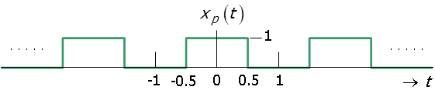
Example 2-2 : Determine the spectrum of
is a periodic square wave which can be written as :
Period of is , hence frequency is Hz or ω₀=π rad/s.
What is the spectrum of ? What are its frequency components?

Slide 18
The complex exponential form is given by :
where

Slide 19
Spectrum of denoted as : amplitude and phase spectra
Amplitude
Spectrum
Phase
Spectrum
-15
-13
-11
-9
-7
-5
-3
-1
0
1
3
5
7
9
11
13
15
→
-7.5
-6.5
-5.5
-4.5
-3.5
-2.5
-1.5
-0.5
0
0.5
1.5
2.5
3.5
4.5
5.5
6.5
7.5
→
-15π
-13π
-11π
-9π
-7π
-5π
-3π
-π
0
π
3π
5π
7π
9π
11π
13π
15π
→

Slide 20
Since is real, the magnitude and phase spectra can be combined into a single spectrum.
Phase of π and –π denotes a negative number.
Phase of 0 denotes a positive number.
Spectrum
-15
-13
-11
-9
-7
-5
-3
-1
0
1
3
5
7
9
11
13
15
→
-7.5
-6.5
-5.5
-4.5
-3.5
-2.5
-1.5
-0.5
0
0.5
1.5
2.5
3.5
4.5
5.5
6.5
7.5
→
-15π
-13π
-11π
-9π
-7π
-5π
-3π
-π
0
π
3π
5π
7π
9π
11π
13π
15π
→

Slide 21
What does tells us about the signal ?
Using the relationship, , we can obtain the alternative trigonometric form as follows :

Slide 22
Simplifying further, we get :
This tells us that has the following components :
Frequencies | Amplitude | Phase | Remarks
0 rad/s | 0.5 | 0 | DC component (average value)
π rad/s | 2/π | 0 | Fundamental frequency
3π rad/s | 2/(3π) | -π rad | 3rd harmonic frequency
5π rad/s | 2/(5π) | 0 rad | 5th harmonic frequency
7π rad/s | 2/(7π) | -π rad | 7th harmonic frequency
The pattern continues and only odd harmonics are present in this signal

Slide 23
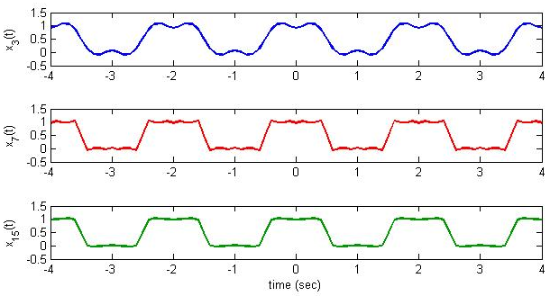
How can be reconstructed from the Fourier coefficients?
is reconstructed by adding components up to ith harmonics as follows :

Slide 24
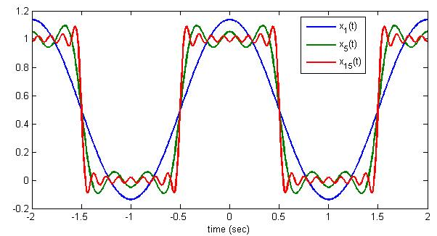
This graph shows very clearly that if more components are used in the reconstruction, the better it approximates the original square wave signal

Slide 25
What conclusions can you draw from the Fourier Series?
Fourier Series (FS) allow you to decompose periodic signals into its constituent frequency components
There are 3 forms of the FS : 2 are trigonometric forms + 1 exponential form
The exponential form gives rise to negative frequencies
We derive the amplitude and phase spectra of a signal from the FS
The amplitude and phase spectra (together known as simply the spectrum of the signal) are discrete in frequencies for periodic signals
What happens when the signal is non-periodic or aperiodic?

Slide 26
Self-Test Problems
Decompose the following signals into their frequency components and sketch their spectra :
1
1
1
……..
……..
-4
-3
-2
-1
0
1
2
3
4
Time (sec)
Check out : http://www.jhu.edu/signals/listen-new/listen-newindex.htm
http://www.falstad.com/dfilter/

